Slide 1
Final Project Presentation
To Be Continued

Slide 2
Group Info
David Walker
Nick Witmer
Jenia Rousseva
Eastern Washington University
CSCD350
Fall Quarter 2015

Slide 3
Project
Trivia Maze

Slide 4
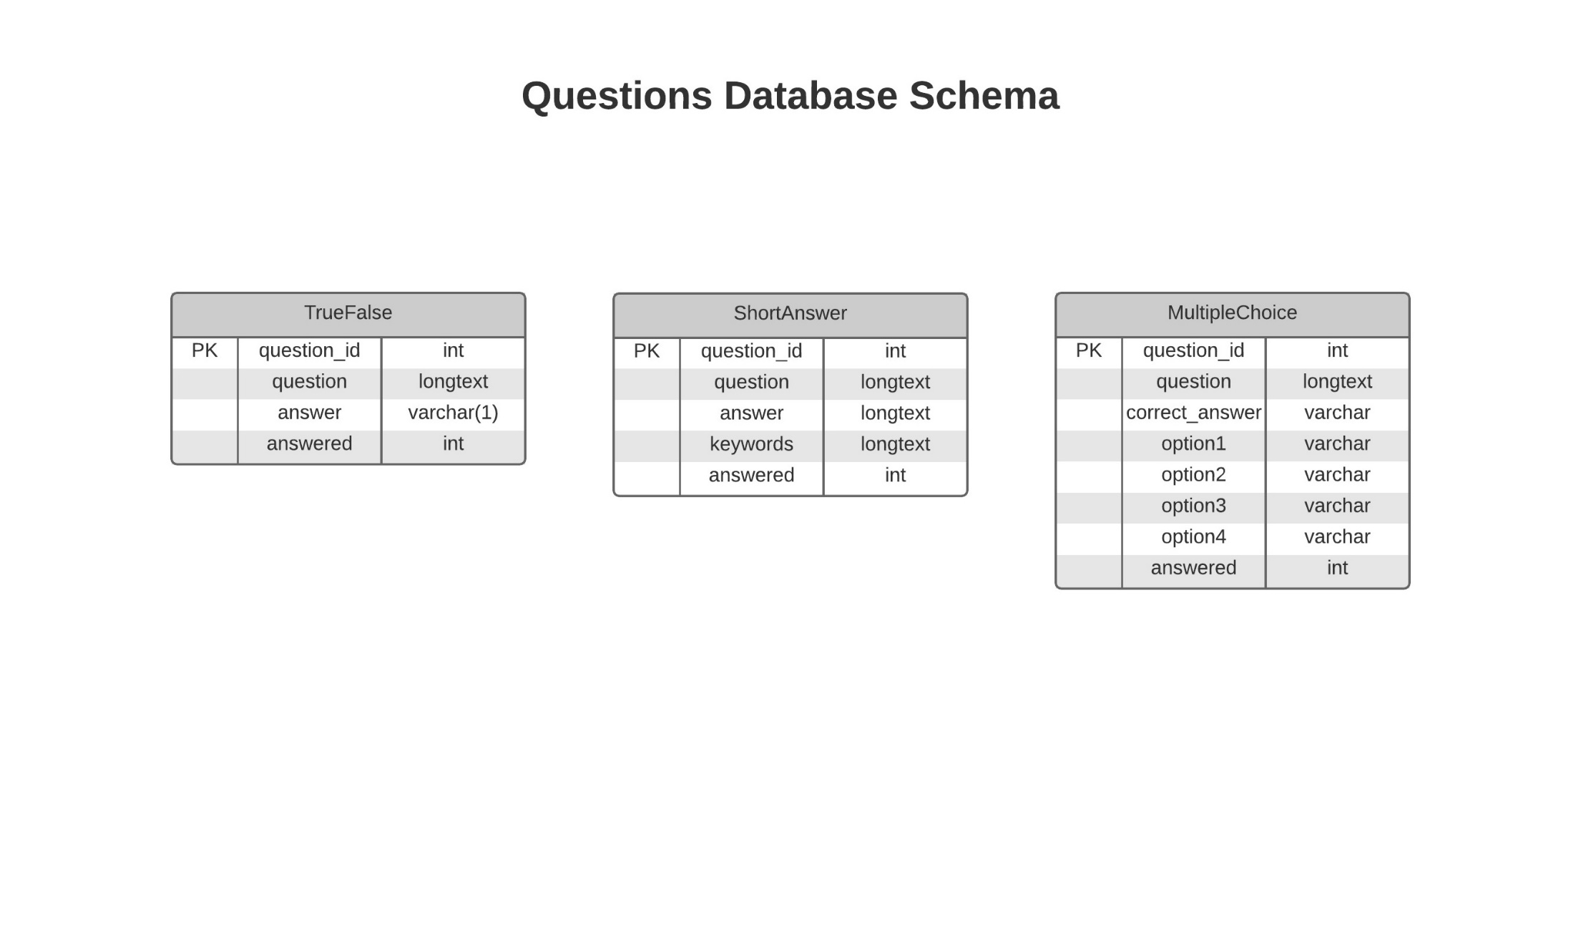

Slide 5
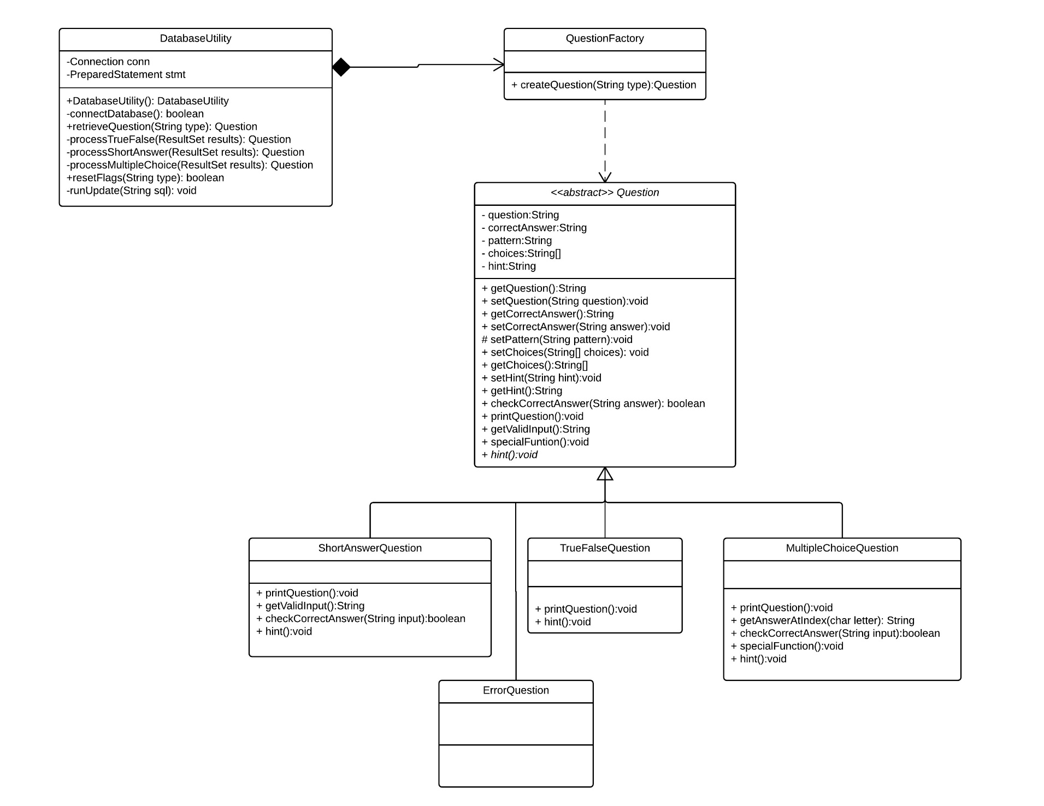
Question Hierarchy and Retrieval

Slide 6
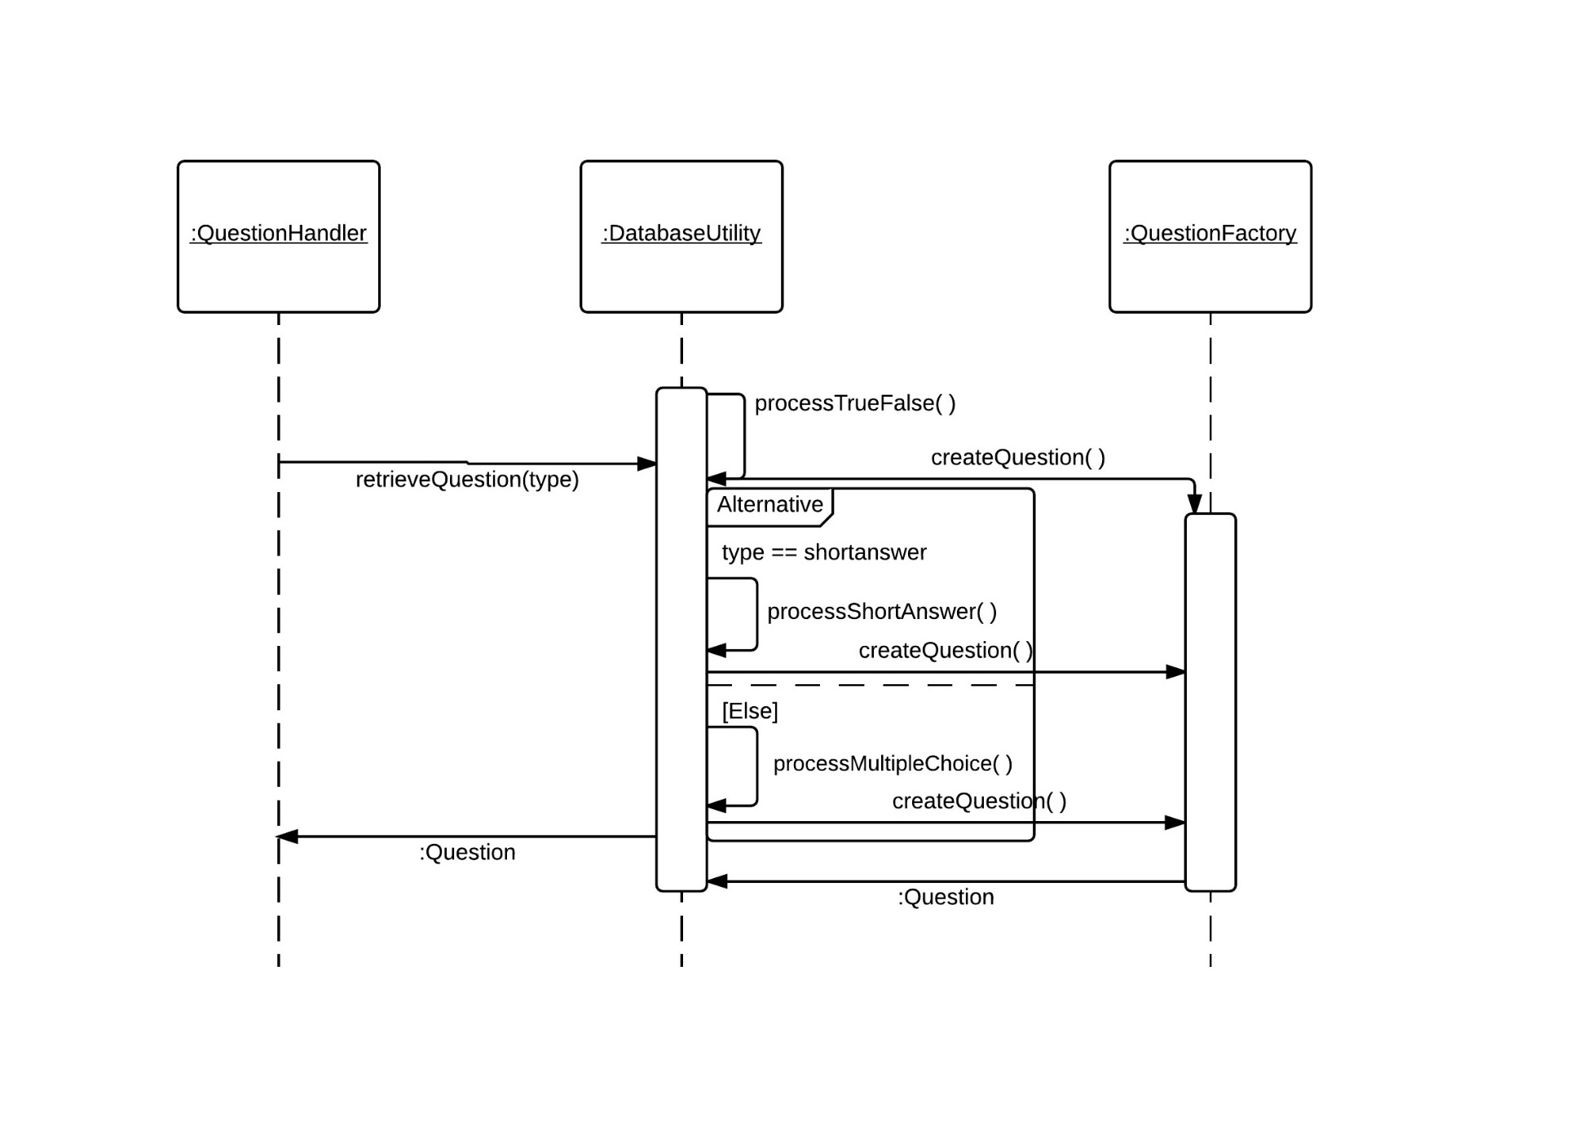
Question Retrieval Sequence

Slide 7
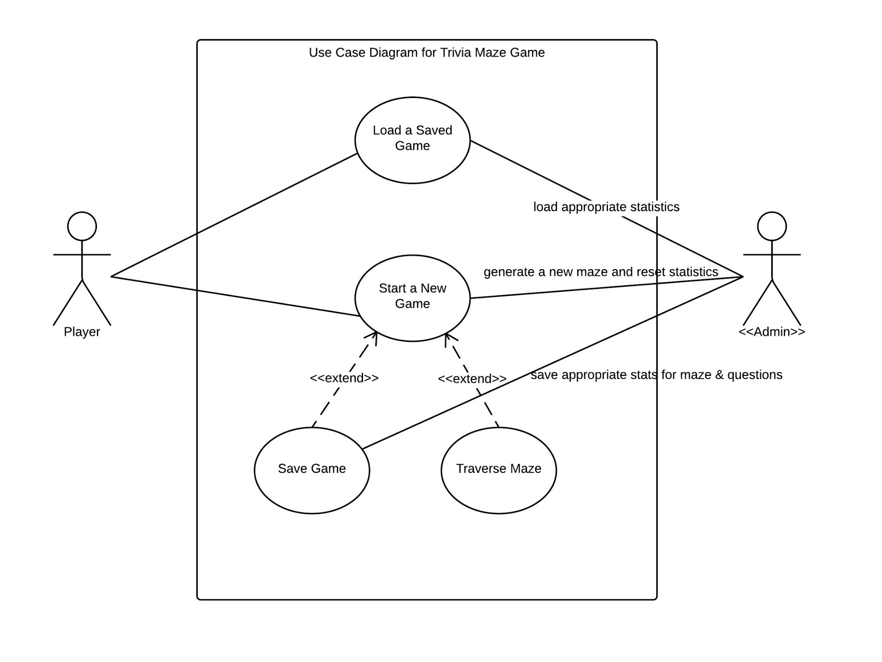

Slide 8
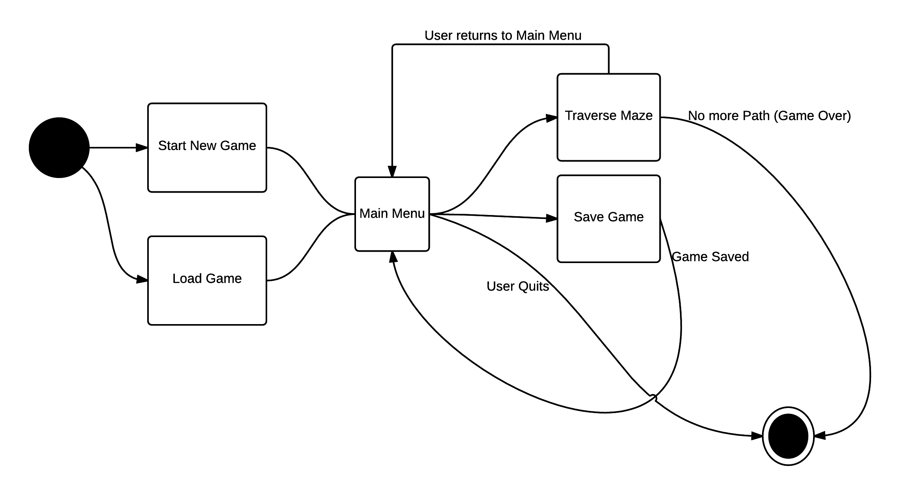
Game State

Slide 9
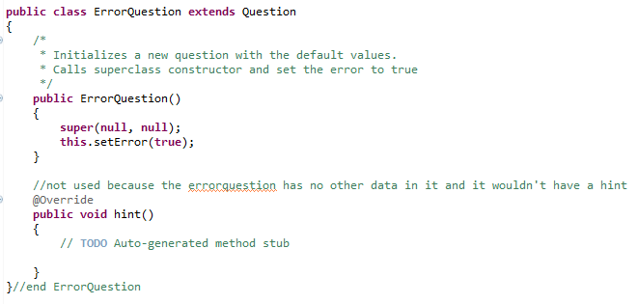
NULL OBJECT PATTERN

Slide 10
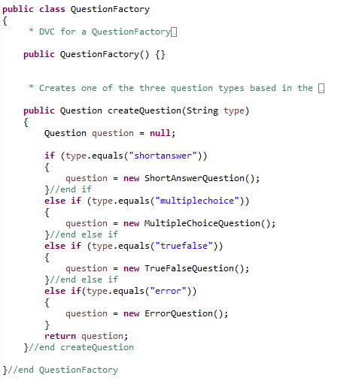
Factory Pattern

